Slide 1
Lead Scoring Case Study
Date: 26/02/2023

Slide 2
Business Problem
An education company named X Education sells online courses to industry professionals.
Although X Education gets a lot of leads, its lead conversion rate is very poor.
For example, if say, they acquire 100 leads in a day, only about 30 of them are converted.
The objective is to build a model to identify the hot leads and achieve lead conversion rate to 80%.

Slide 3
Business Objective
The Business Objective Is To Build A Logistic Regression Model To
Identify The Hot/Potential Leads And Achieve The Lead Conversion
Rate To 80%.

Slide 4
Now Lets try to understand our Dataset

Slide 5
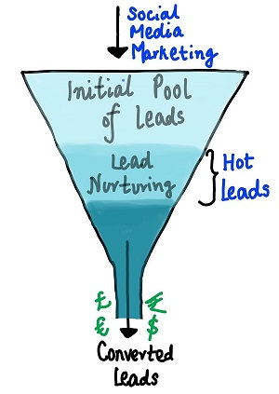
Understanding Dataset
We got a file named “Leads.csv”provided with a leads dataset from the past with around 9000 data points.
This dataset consists of various attributes such as Lead Source, Total Time Spent on Website, Total Visits, Last Activity, etc. which may or may not be useful in ultimately deciding whether a lead will be converted or not.
To learn more about the dataset we got the data dictionary.
The target variable, in this case, is the column ‘Converted’ which tells whether a past lead was converted or not wherein 1 means it was converted and 0 means it wasn’t converted.
Another thing that to check out for are the levels present in the categorical variables. Many of the categorical variables have a level called 'Select' which needs to be handled because it is as good as a null value. Understanding Dataset

Slide 6
Approach Taken
Business Understanding
Data Sourcing
Data cleaning & Manipulation
EDA
Data Visualisation
Data Preparation
Model Building
Model Evaluation

Slide 7
Data Cleaning
Handling ‘Select’ variable
“Select” variable indicates that the user has not selected any option.
We impute the same with null values
Dropping Score and Activity variables
Score and Activity variables : This is the data that is obtained after contact with the lead. So we need to remove them.
Score variables: Tags, Lead Quality, Lead Profile, Activity Index, Activity Score and Profile Score
Activity variables: Last Notable Activity
Treating Categorical data
High Data Imbalance –Columns having high data imbalance must be removed. For e.g. : Category A has 98% , and Category B has 2% - This data is irrelevant to our analysis as one category is overpowering the other.
In other categorical columns where there are columns with small percentages should be removed
Dropping column with high null values
Columns having null values greater than 40% does not have meaning to the data, hence we drop these columns
For Specialization, we consider the column where people have not selected any value into one more column known as Not Specified and we use this for model building

Slide 8
EDA : Numerical Data

Slide 9
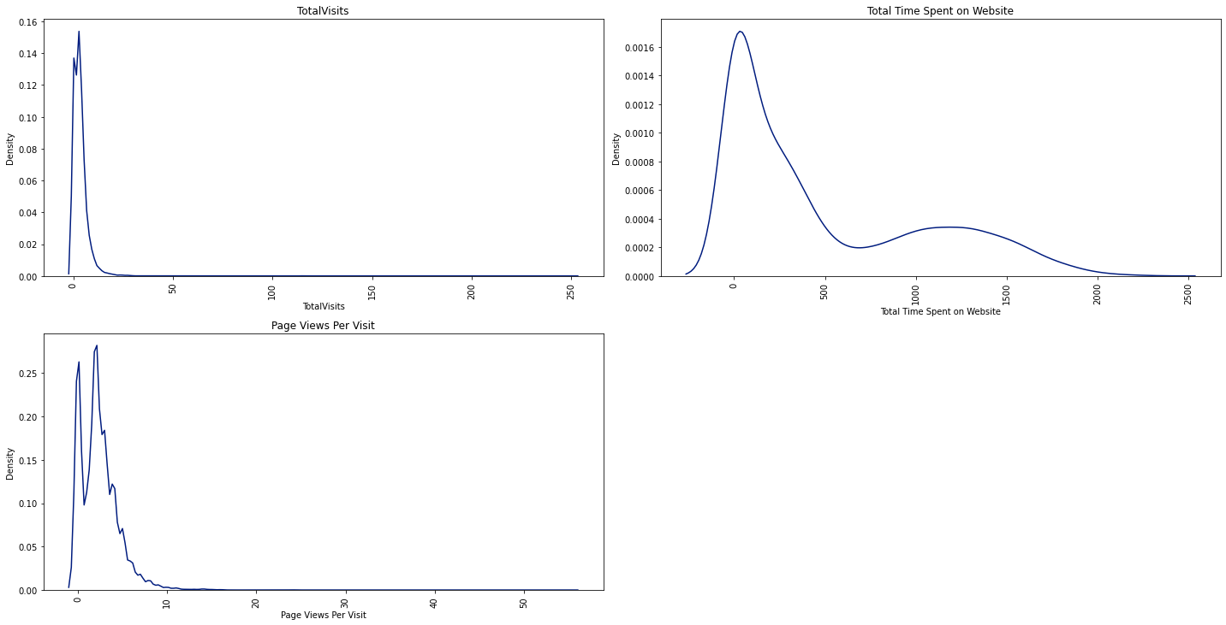
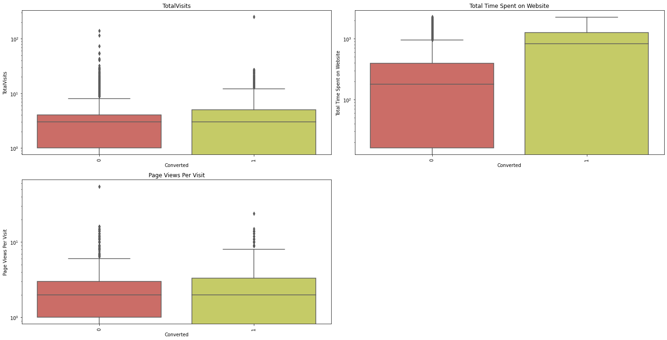
Total Visits
The max probability for Total Visits is found to be around 15-20. It increases initially but decreases further.
The average total visits for both converted and unconverted people is found to be the same. Total Time Spent On The Website

Slide 10
Total Time Spent On The Website
The probability of time spent is found to be high for time between 0-300 seconds and decreases further.
The mean is found to be higher in case of Converted people rather than non- converted people.

Slide 11
Page Views Per Visit
The max probability for Page Views Per Visit is found to be around to be 3-5.
The average page views for both converted and unconverted is found to be the same.

Slide 12
EDA : Categorical Data

Slide 13
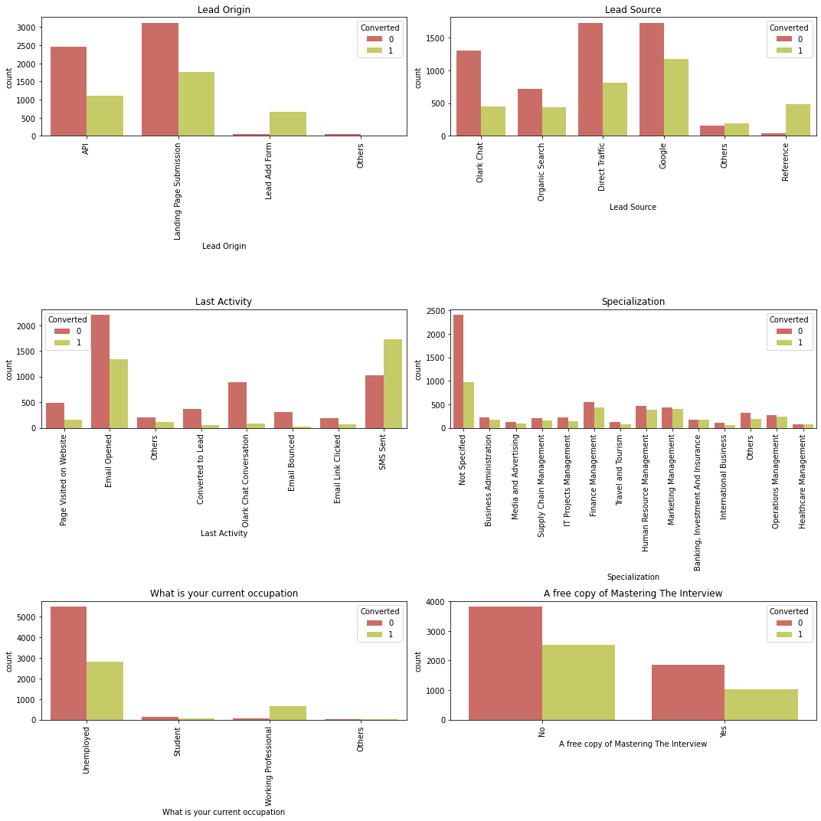
Lead Origin
The percentage of Converted people is found to be greater for Landing Page Submission.
We can also see that if Lead source is Add Form, the ratio of lead conversion is very high (almost not converted is very less).

Slide 14
Lead Source
Google is found to be the important source for Lead Conversion
Direct Traffic also proves to be important to secure leads.

Slide 15
Last Activity
We need to target people via Emails and SMS as it is found that the probability of response in case Converted leads is found to be higher.

Slide 16
Data Preprocessing
Number of features after scaling and dummy variable creation : 35
Target Variable : Converted o Libraries used: StandardScaler()
Columns that are not considered : Lead Number and Prospect ID (these variables do not help in model building)
The steps are as follows:
Outlier Treatment: Total Visits and Page Views Per Visit had some outliers. We perform capping using Soft Capping (Checking for 99th percentile) and complete the outlier treatment process before we continue to the next step.
Binary Mapping: A free copy of mastering the interview” contains values in terms of Yes/No , we convert these to 1/0 so it converts into numerical values and helps in model building
Dummy Variable Creation: We need to create dummy variables for all the categorical columns as they enable us to use a regression equation on multiple groups
Test Train Split: Division of data into test data and train data to check the stability of the model. We have randomly sampled 70% of the data as the test data and 30% of the data as test data.Random State = 100
Scaling: Division of Train Data into X and Y where X has all the features and Y has the target variable –Converted. We perform scaling to normalize the data within a particular range. Technique used Standard Scaler

Slide 17
Model Building
Model –I and II: Basic Model
We build a basic model using 35 features. Since it is not efficient we perform RFE to obtain a model with Top –20 features. There are so many variables with high p-values and VIF value, we need to remove them.
Model –III and IV : Removing variable with p-values > 50%
Two columns having p –values > 50% : Lead Source_Others and Lead Source Origin
Since p –value > 50% , it does not seem to significant at all.
Model V, VI and VII : Removing variables having p-value > 10%
Since we have a cut off for significance value > 10 % does not improve our model.
Hence, we remove these variables which are : Current Occupation Student , Specialization International Business and LastActivityEmail.
Model VIII : Removing variables having high VIF
After model –VII , all p-values < 5%, hence we need to check VIF.
VIF for Current Occupation_Unemployed = 12.20 which is > 5% .
Hence we drop this variable from our analysis
Model –VIII : The Final Model
All p-values < 5% - Hence they are highly significant .
All VIF values are < 5. Hence the dependency of variable with another is tolerable.
Final model has 14 features in total.

Slide 18
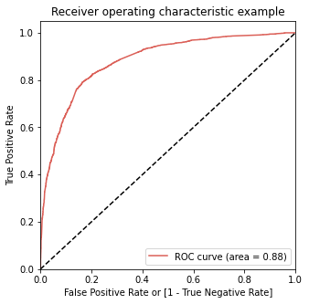
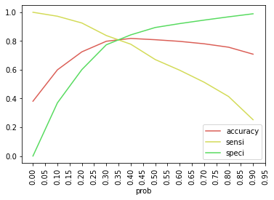
ROC Curve And Optical Cut-Off Probability
ROC Curve represents how much the model is able to distinguish between the classes.
AUC –Area under the curve represents that it is distinguishing the 1’s and 0’s correctly.
On plotting the ROC curve for our data we see that, AUC is around 0.88 which means at around 88% of the times, the model is able to distinguish the 1’s as 1’s and 0’s as 0’s.
AUC of 0.88 is found to be very stable model.
When we plot the sensitivity, accuracy and specificity of the model together, the optimal cut off point is found to be at 0.35. This means that at 35% probability, the sensitivity and specificity are found to be balanced.
With probability = 0.35 , we predict yValues with xTrain, in such a way that, any conversion prob > 35% is said to be converted to a lead.

Slide 19
Model Performance Test
Train Set
ACCURACY - 81.19%
SENSITIVITY - 80.45%
SPECIFICITY - 81.7%
Test Set
ACCURACY - 80.08%
SENSITIVITY - 80.0%
SPECIFICITY - 80.3%
Note: The sensitivity value after model building process is found to be greater than 80% as required. When the model is evaluated for Test Set, the model evaluation parameters remains to be the same. Hence the model is highly stable.

Slide 20
Lead Score And Conversion Rate
Conversion Rate is the number of customers who are converted to leads and interested in the course.
Before model building the Conversion Rate was found to be 38.53% .
After model building, the conversion rate is increased to 72.87% .
Hence we can conclude that our final model has served to the business purpose

Slide 21
Hot Leads
Hot leads are people who have a high probability to be converted as a Lead and thus needs to be identified. They have a higher conversion rate.
The leads whose lead score is greater than 35% are considered as potential leads. The conversion rate is around 73%. When we increase this threshold from 35% to 95% we get Hot Leads.
Conversion Rate for hot leads is increases from 73% to 96%. This means they have a 96% probability of getting converted to a lead.
Focusing on Hot Leads will increase the chances of obtaining more value to the business as the number of people we contact are less but the conversion rate is high.

Slide 22
Conclusion
Equation :-
-1.0565 * const + 0.1944 * TotalVisits + 1.0574* Time Spent -0.3186 * Free Copy -1.0199 * Lead Origin_Landing
Page Submission + 4.4017 * Lead Origin_Lead Add Form + 1.2101 * Lead Source_Olark Chat-1.1764 * Lead
Source_Reference -1.1921 * Last Activity_Email Bounced + 0.8166 * Last Activity_Email Opened -0.6859 * Last
Activity_Olark Chat Conversation + 0.6463 * Last Activity_Others - 1.9097 * Last Activity_SMS Sent -1.1380 *
Specialization_Not Specified + 2.6908 * Current Occupation_Working Professional
The customer/leads who fills the form are the potential leads.
We must majorly focus on working professionals.
We must majorly focus on leads whose last activity is SMS sent or Email
opened.
It’s always good to focus on customers, who have spent significant time on
our website.
It’s better to focus least on customers to whom the sent mail is bounced
back.
If the lead source is referral, he/she may not be the potential lead.
If the lead didn’t fill specialization, he/she may not know what to study
and are not right people to target. So, it’s better to focus less on such cases.

Slide 23
Recommendations
It’s good to collect data often and run the model and getupdated with the potential leads. There is a belief that the best time to call your potential leads is within few hours after the leadshows interest in the courses.
Along with phone calls, it's good to mail the leads also to keep them reminding as email is as powerful as cold calling.
Reducing the number of call attempts to 2-4 and increasing the frequency of usage of other media like advertisements in Google, or via emails to keep in touch with the lead will save a lot of time.
Focusing on Hot Leads will increase the chances of obtaining more value to the business as the number of people we contact are less but the conversion rate is high.

Slide 24
THE END

